Slide 1
Microsoft Azure Service Fabric Architecture
Sonu Sathyadas
Tech Lead & Training Consultant
Synergetics India Pvt Ltd

Slide 2
Agenda
Application development
Azure Service Fabric
Microservices
Reliability & scale-out
Lifecycle management
Summary

Slide 3
Application development in the age of the Cloud
Features
Scalability
Availability
Latency
Lifecycle
Data Integrity
Portability
Manage Services
Deliver Features Faster
Create Business Value

Slide 4
Cloud Service Architectures
Features
traditional
Scalability
Microservices
User Interface
Availability
User Interface
Business Logic
Data
Latency
Business Logic
Lifecycle
Data Integrity
Data
Portability
Manage Services
Deliver Features Faster
Create Business Value

Slide 5
Microsoft Azure Service Fabric A platform for reliable, hyperscale, microservice-based applications
Microservices
Service Fabric
Container Orchestration & lifecycle management
Application Programming Models
High Availability
Hybrid Operations
Data Partitioning
Health Monitoring
Self-healing
Simple programming models
High Density
Rolling Upgrades
Low Latency
Placement Constraints
Replication & Failover
Stateful services
Fast startup & shutdown
Load balancing
Hyper-Scale
Automated Rollback
Windows
Server
Linux
Windows
Server
Linux
Azure
Hosted Clouds
Windows
Server
Linux
Private Clouds

Slide 6
Battle-hardened for over 5 years
Skype for Business
Hybrid Ops
Azure Document DB
billions transactions/week
Intune
800k devices
Azure Core Infrastructure
thousands of machines
Event Hubs
20bn events/day
Bing Cortana
500m evals/sec
Azure SQL Database
1.4 million databases
Power BI

Slide 7
Microsoft Azure Service Fabric A platform for reliable, hyperscale, microservice-based applications
Microservices
Service Fabric
Container Orchestration & lifecycle management
Application Programming Models
High Availability
Hybrid Operations
Data Partitioning
Health Monitoring
Self-healing
Simple programming models
High Density
Rolling Upgrades
Low Latency
Placement Constraints
Replication & Failover
Stateful services
Fast startup & shutdown
Load balancing
Hyper-Scale
Automated Rollback
Management
Communication
Reliability
Hosting
Subsystem
Testability
Windows
Server
Linux
Windows
Server
Linux
Azure
Hosted Clouds
Federation
Windows
Server
Linux
Private Clouds
Transport

Slide 8
What is a microservice?
Is (logic + state) that is independently versioned, deployed, and scaled
Has a unique name that can be resolved
e.g. fabric:/myapplication/myservice
Interacts with other microservices over well defined interfaces and protocols like REST
Remains always logically consistent in the presence of failures
Hosted inside a “container” (code + config)
Can be written in any language and framework
node.js, Java VMs, any EXE
Developed by a small engineering team

Slide 9
Types of microservices
Stateless microservice
Has either no state or it can be retrieved from an external store
There can be N instances
e.g. web frontends, protocol gateways, Azure Cloud Services etc.
Stateful microservice
Maintain hard, authoritative state
N consistent copies achieved through replication and local persistence
e.g. database, documents, workflow, user profile, shopping cart etc.

Slide 10
Demo
Stateless microservice

Slide 11
Federation and transport subsystems
Microservices
Application Programming Models
Management
subsystem
Communication
subsystem
Reliability
subsystem
Activation
subsystem
Testability
subsystem
Federation
Transport

Slide 12
Typical datacenter
A set of independent machines; physical or virtual

Slide 13
Cluster: A federation of machines
A set of machines that Service Fabric stitches together to form a cluster
Clusters can scale to 1000s of machines
Node
Node
Node
Node
Node
Node

Slide 14
Machine failure detection
Time = t₀
83
46
76
50
64
Nodes failed
Time = t₁
83
46
76
50
64
61
New Node arrived
Time = t₂
cluster reconfigured
83
46
Failures Detected
50
61

Slide 15
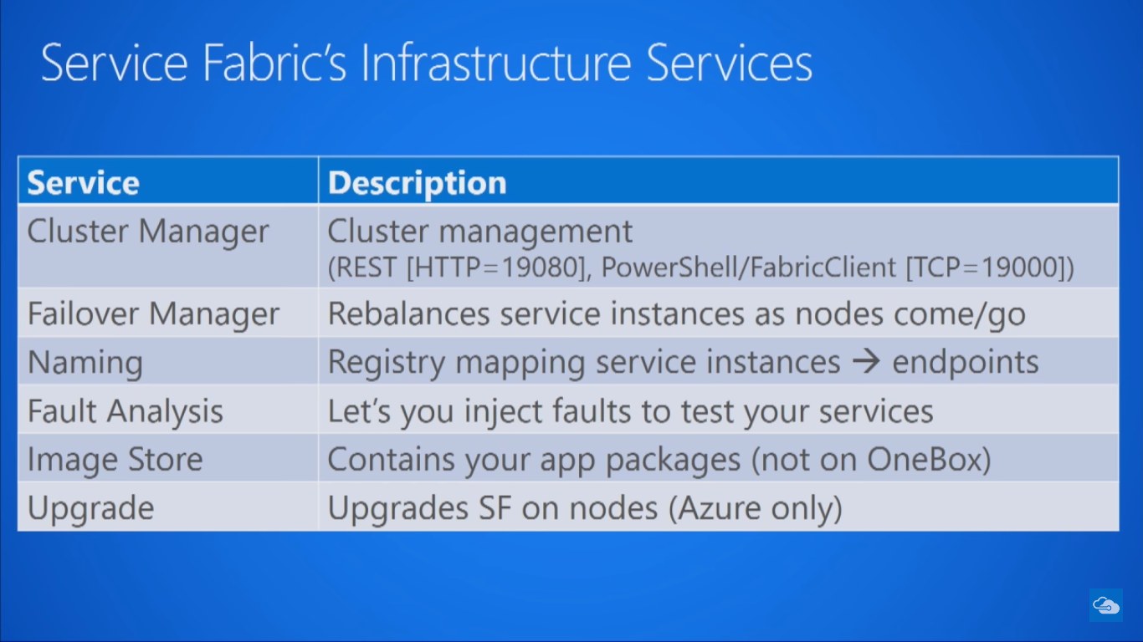

Slide 16




Cluster: System view
System Services
Failover
manager
Cluster
manager
Naming
Image
store
Notes:
Cluster Manager – Life Cycle Management, Manages patches and updates
Fail over Manager – Manages the reliability by spawning new node when one nodes goes down
Naming – Identifies the endpoints, Maps services to endpoints
ImageStore – Store the code and configurations

Slide 17
Demo
Service Fabric Explorer

Slide 18
Reliability and hosting subsystems
Microservices
Application Programming Models
Management
subsystem
Communication
subsystem
Reliability
subsystem
Hosting
subsystem
Testability
subsystem
Federation
Transport

Slide 19






3-Tier service pattern
Scale with partitioned storage
Increase reliability with queues
Reduce read latency with caches
Manage your own transactions for state consistency
Many moving parts each managed differently
Load Balancer
Front End
(Stateless
Web)
Stateless
Middle-tier
Compute
Cache
Queues Storage

Slide 20

Stateful services: Simplify design, reduce latency
Application state lives in the compute tier
Low Latency reads and writes
Partitions are first class for scale-out
Built in transactions
Fewer moving parts
Load Balancer
Front End
(Stateless
Web)
Stateful
Middle-tier
Compute
data stores used for analytics and disaster recovery

Slide 21
Stateful microservice
Demo

Slide 22
Stateful microservices are reliable and consistent
Each service is backed by replica set to make its internal state reliable
All replicas are logically consistent – meaning all replicas see the same linearized order of read and write operations to initial state
Read-Write quorums are supported and are dynamically adjusted
Replica set is dynamically reconfigured to account for replica arrivals and departures

Slide 23

Stateful microservice
Application Package
replication
replication
S
S
P
S
S
P

Slide 24
Replication
Reads are completed at the primary
Writes are replicated to the write quorum of secondaries
Ack
Read
Value
Write
Ack
P
Ack
Ack
Ack
S
S
S
Write
S
Write
Write
Write

Slide 25
Reconfiguration
Types of reconfiguration
Primary failover
Removing a failed secondary
Adding recovered replica
Building a new secondary
Replica States
None
Idle Secondary
Active Secondary
Primary
X
Failed
P
S
P
B
S
S
X
Failed
S
S
Must be safe in the presence of cascading failures

Slide 26
Microservices placement and failover
Node 100
Node 101
Node 102
Node 103
Node 104
Node 105
P
S
P
P
S
P
S
S
S
P
S
S
S
S
P
S
S
S
S
S
S
S
S
S

Slide 27
Cluster Monitor
Demo

Slide 28
Application Lifecycle Management
Microservices
Application Programming Models
Management
subsystem
Communication
subsystem
Reliability
subsystem
Hosting
subsystem
Testability
subsystem
Federation
Transport

Slide 29
Application: logical grouping of microservices
Application
Container
Container
Container
Container

Slide 30
Application Lifecycle Management
Provisioning and deployment of constituent microservices
Upgrade microservices without loss of availability
Monitor microservices
Interface with machine management layer for autoscale and initiating reboot, reimage, and repair actions
Provide operational insight into aggregate utilization – inventory, performance counters/metrics, etc. – for capacity planning

Slide 31
No Downtime Upgrade
Demo

Slide 32
Upgrading Services with zero downtime
FD1/UD6
Application Package
FD0/UD0
FD1/UD5
FD0/UD1
FD2/UD4
FD2/UD3

Slide 33
Testability subsystem
Microservices
Application Programming Models
Management
subsystem
Communication
subsystem
Reliability
subsystem
Hosting
subsystem
Testability
subsystem
Federation
Transport

Slide 34
Azure Service Fabric
Rapidly develop microservice based applications
Operate reliable, scalable services
Enjoy the confidence of a battle-tested platform
Stateless or Stateful
Visual Studio tools
Focus on features not
Infrastructure
Rolling upgrades
Automatic Orchestration
Hybrid Operation
Self-healing
Self-sufficient
Comprehensive
The same technology Microsoft uses
Proven more than 5 years
Investment and roadmap

Slide 35
Call to Action
Download the Service Fabric developer SDK
http://aka.ms/ServiceFabric
Learn from the tutorials and videos
http://aka.ms/ServiceFabricdocs
Attend other talks
BRK3730: Building Resilient, Scalable Services with Microsoft Azure Service Fabric – Tuesday @ 1:30 pm
BRK3478: Deploying and Managing Services with Microsoft Azure Service Fabric – Wednesday @ 5:00 pm
BRK3485: Service Orchestration with Microsoft Azure Service Fabric – Thursday @ 1:30 pm
BRK3476: Microsoft Azure Service Fabric Actors: The Director's Cut – Thursday @ 5:00 pm
Provide feedback
http://aka.ms/ServiceFabricforum
http://stackoverflow.com/questions/tagged/azure-service-fabric
Twitter hashtag #AzureServiceFabric

